Slide 1

Sequence Diagram
pandhi Renuka id: 6167
Nitin kumar gaur id:6168
Date : 24/09/2021

Slide 2

UML(unified Modeling Language)
UML (Unified Modeling Language) is a standard language for specifying, visualizing, constructing, and documenting the artifacts of software systems.
Its Technical method to explain the future product by just drawing some diagram and define the flow of execution of software system.
UML is a modeling toolkit that guides the creation and notation of many types of diagrams, including behavior diagrams, interaction diagrams, and structure diagrams.

Slide 3

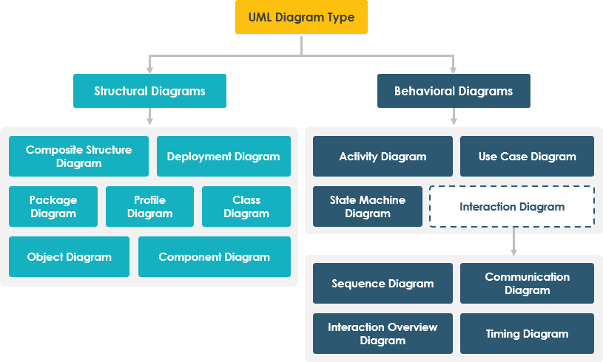
What’s next
LOOKING AHEAD

Slide 4
1.Sequence diagrams describe interactions among classes in terms of an exchange of messages over time. They're also called event diagrams 2. A sequence diagram is a type of interaction diagram because it describes how—and in what order—a group of objects works together. These diagrams are used by software developers and business professionals to understand requirements for a new system or to document an existing process
Sequence diagram

Slide 5
Basic symbols and components of sequence diagram
Symbol Name Description

Slide 6

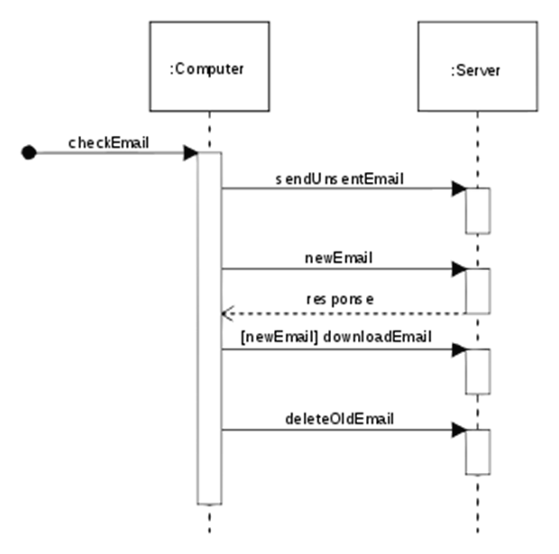
Sequence diagram

